Slide 1


Orientation and Self Assessment of Researchers
Basic Seminar for EURAXESS Staff
Online, 29 Feb 2024
The ERA TALENT project has received funding from the European Union’s Horizon Europe research and innovation programme under grant agreement No 101103476

Slide 2
Introduction of participants
Please, share with us:
Your name,
Your organisation,
Country
If you are a newcomer up to 1 year of experience or
More experienced colleague already for more than 5 years with EURAXESS

Slide 3
Why we gathered today?
AGENDA:
Introduction on career path of a researchers and their needs at different career stages
EURAXESS tools available on the European and national portals that we can use
Sharing experience of using these tools
Discussion on our internal practices and tools for orientation and self assessment of researchers
EURAXESS Communities of Practice for sharing Good Practice
EURAXESS European and local hubs building ties and new tools to support our work

Slide 4
Still why we gathered today?
Expected outcome:
To become aware of researchers’ needs at different career stages
To learn more about EURAXESS tools available on the European and national portals that we can use
To exchange experience of using these tools
To learn about other internal practices and tools for orientation and self assessment of researchers
To understand what are EURAXESS CoPs and Hubs and how to make use of them

Slide 5


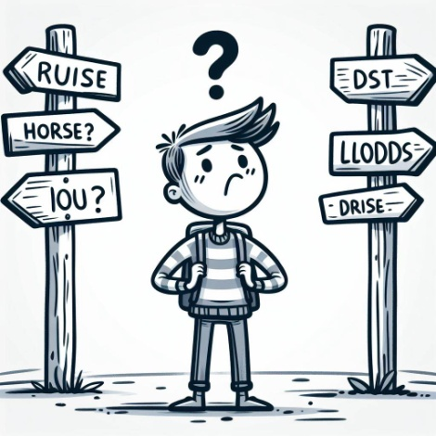


*These pics and graphs are created by the MS Copilot
Stages:
PhD student
Early Post Doc
Some experience in independent research
Experienced
Needs

Slide 6

Exercise !
Please, list in the chat what are the needs of a PhD student!
*These pics and graphs are created by the MS Copilot

Slide 7
Exercise !
What about the needs of a early Post Doc?
*These pics and graphs are created by the MS Copilot

Slide 8
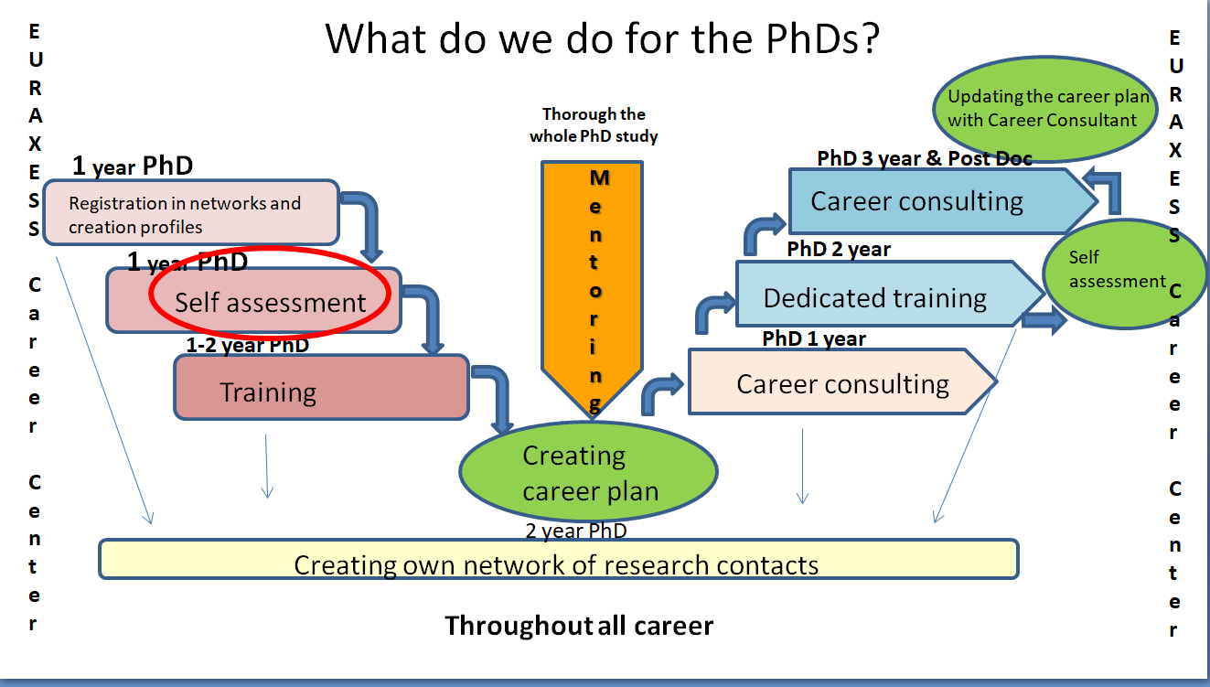
Career path of a
PhD student
Maybe not all of us but some do
* This graph is mine and you can use it for free without any concern about my IPR!

Slide 9
Exercise !
Do we have at EURAXESS tools available to match these needs?
*These pics and graphs are created by the MS Copilot

Slide 10
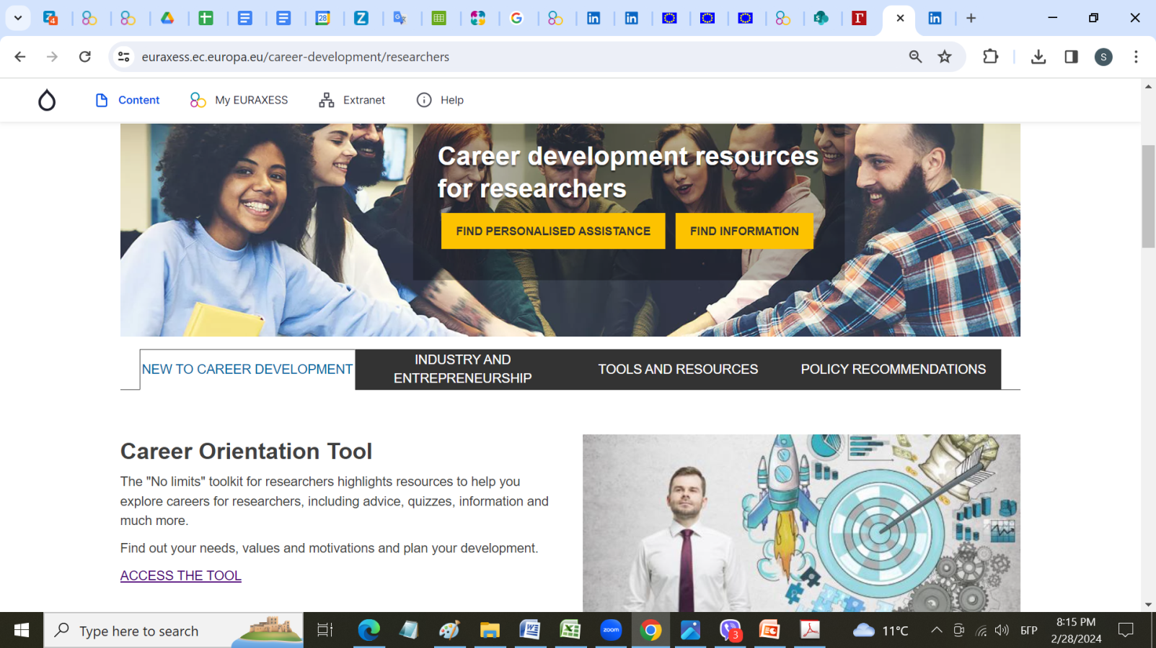
EURAXESS tools
Let’s check together what we have on the portal!
https://euraxess.ec.europa.eu/career-development/researchers
*These pics and graphs are created by the EC ☺

Slide 11
EURAXESS tools
Here is the list of the tools that may make your life easier (!)
and at the same time enlarge your service (!!!)
towards the early stage researchers:
1
Career Orientation Tool
https://euraxess.eventiotic.com/piperstool/
Self assessment :
motivations, skills, advice, links to tools for preparing career plan
Career Handbook for Young Researchers
https://euraxess.eventiotic.com/piperstool/
Self assessment more resources :
motivations, skills, advice, links to tools for preparing career plan
https://euraxess.ec.europa.eu/career-development/researchers/career-handbook-young-researchers/handbook-subpage
https://euraxess-reflex.saia.sk/en/main/reflex-app/
Virtual webinars & trainings & trainings
https://euraxess.ec.europa.eu/career-development/researchers/virtual-webinars-trainings

Slide 12
EURAXESS tools
Here is the list of the tools that may make your life easier (!)
and at the same time enlarge your service (!!!)
towards the early stage researchers:
2
International Mentoring Program
https://mentoring.euraxess.bg/
Global mentoring opportunity to mobile and non-mobile researchers
Intercultural Assistant Tool
https://euraxess.ec.europa.eu/career-development/researchers/intercultural-assistant
Introduction to culture, differences, 2 self paced courses short & long
Talent Development Suite
https://science-stories.ch/tds/
Personal career development planning
PIPERS Project Career Kit
https://euraxess.ec.europa.eu/career-development/researchers/pipers-project-career-kit

Slide 13

EURAXESS tools
Internship Program
for Refugee and Displaced
Researchers in Europe
https://internship.euraxess.bg/
3
Open for applications to 20 Mar 2024
Financial Support for Companies, NGOs and Refugee Researchers to Host Internships for Refugee Researchers

Slide 14

Discussion!
Share your experience of using these tools
Share your internal practices and tools for orientation and self assessment of researchers
*These pics and graphs are created by the MS Copilot

Slide 15
Supporting mobility and procedures, including entry conditions, social security, taxation; with potentially further topics of interest) (NUFFIC: leader, SAIA: co-leader in subtopics, IUA, AMEUP, NAWA: contributors)
Social integration and Dual Careers (UCPH leader, OeAD: co-leader in subtopics, NUFFIC, SSC AV CR, ASM: contributors)
Cooperation with stakeholders outside academia/industry for intersectoral mobility, including scientific startup entrepreneurship (FECYT: leader, MEF, IPD, RIF: contributors)
Talent/Brain circulation, including cooperation with EURAXESS Worldwide (SAIA leader, ETH Zurich, SU, CERTH, FCT: contributors)
Diversity, inclusion and gender issues (ETH Zurich: leader, UNIBL, UCPH, RANNIS: contributors)
Recruitment services towards a career in the academic and non-academic public sector (RCN: leader, AMEUP, NAWA: contributors).
EURAXESS Communities of Practice for sharing Good Practice established in ERA Talent project
Contact:
Siiri Kolka, ETAg, EE,
siiri.kolka@etag.ee

Slide 16
EURAXESS Start-up hub, contact: Milan Zdravković, milan.zdravkovic@gmail.com
  https://www.euraxess.rs/serbia/euraxess-startup-hub-digital-toolkit
Research Careers Beyond Academia hub, contact: Elisa García, Xavier Eekhout, Elisa.garcia@fecyt.es, xavier.eekhout@fecyt.es
  https://www.euraxess.es/spain/euraxess-researcher-careers-beyond-academia-digital-toolkit
Research Careers in Academia hub, contact: Sibylle Hodel, sibylle.hodel@sl.ethz.ch
  https://www.euraxess.gr/greece/talent-management-hub
Science4Refugees hub, contact: Svetlana Dimitrova, svetlana@fmi.uni-sofia.bg;
  https://euraxess.ec.europa.eu/jobs/science4refugees
Talent Circulation Hub, contact: Karla Zimanová, karla.zimanova@saia.sk
EURAXESS Hubs established in
EURAXESS Hubs and
ERA Talent projects

Slide 17


Thank you!
Благодаря!

