Slide 1
Mentoring Programme “Shape the future of a Researcher Coming to Europe”
Monthly Meeting, July 2023
Mentoring Programme Coordinator – EURAXESS BHO at Sofia University “St. Kliment Ohridski”
The programme has been developed within the EURAXESS TOP IV project “EURAXESS Open to the World” and is financed by the European Commission under H2020-SwafS-2016-17, 786133

Slide 2
Agenda
Update about the program
Why mentoring is important
The roles and responsibilities of Mentors
Communication strategy for successful Mentoring Relationship
What are the benefits of the mentoring
How it works
The role of the Mentoring Program Coordinator
Discussions

Slide 3
The Mentoring Programme update
Since the beginning of operation, the MENTORING PROGAM:
Registered about 1100 researchers from all over the world
207 of them are mentors
226 couples get matched in the program

Slide 4
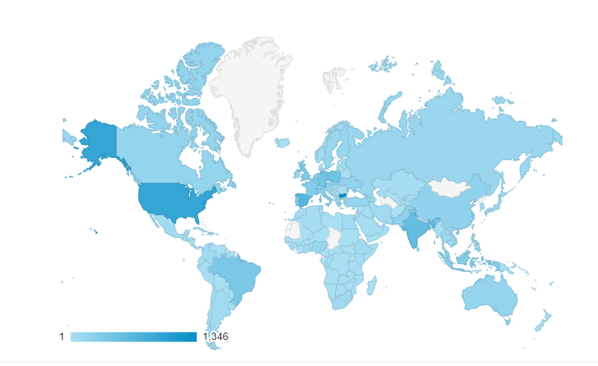
The Mentoring Program map
Website visitors

Slide 5
EURAXESS Mentoring program Linked In group
LinkedIn group for discussion,
sharing news & highlights
448 members of the LinkedIn group
Posts for the period of existing
Lectures and webinars
News and upcoming events
Comments, Impressions and Recognition!
Presenting mentors in the program
Job announcements
https://www.linkedin.com/groups/9090864/

Slide 6
Why is Mentoring important?
Skills development
Create international connections
Gain valuable insight into how other research organizations and systems work
Facilitate transnational mobility

Slide 7
What a Mentor must be able to:
Be a Role model
Offer valuable and beneficial assistance to a mentee
Be willing to help mentees growth
Have active listening skills
Focus on mentee non judgmental and respectful
Know how to develop trusting relationship
Collaborate with others

Slide 8
The MENTOR’s role
Helps set realistic goals
Shares knowledge and own experience
Ask questions and offers guidance and support
Gives honest and constructive feedback
Challenges and encourages to facilitate growth
Suggests networking opportunities and acts as a sounding board for ideas

Slide 9
Effective communication strategy
Listen actively - try to understand mentees perspective, and ask open-ended questions to clarify their thoughts and feelings;
Provide feedback - when providing feedback, be specific, timely, and well structured. Also, make sure to frame your feedback in a positive manner and offer suggestions for improvement;
Respect personal and professional boundaries and avoid topics that may be uncomfortable or inappropriate;

Slide 10
Benefits for the Mentors
Sharing knowledge and experience
Developing skills of mentoring and coaching through engagement with mentees
Gaining personal satisfaction through seeing mentees develop and flourish
Learning new perspectives by working with someone of a different background

Slide 11
MENTORING PATH

Slide 12
How it works?
Matching process
https://mentoring.euraxess.bg/mentoring/search

Slide 13
The role of the Mentoring Program Coordinator is:
To provide comprehensive information about the program
To support Researchers with any technical issues related to the program
To support Mentees in selecting the Mentor
To support Mentors in challenging situations
To provide certificates to the couples successfully completed their mentorship

Slide 14
MENTORING:
Is successful when both sides are ACTIVE!
Is WIN / WIN outcome!
Help ALL researchers advance FASTER!
Open the doors of the networking & cooperation!
Make career choices better!
Build global research community!

Slide 15
Promote among your colleagues – we need more MENTORS! https://mentoring.euraxess.bg/user/register

Slide 16
Discussion
Challenges for the Mentors
Ask questions to Mentors
Share how your mentoring couple works/worked
Ask questions to Coordinator

Slide 17
Mentoring Program “Shape the future of a Researcher Coming to Europe”
_________________________________
Should you have any questions:
https://www.linkedin.com/groups/9090864/
Contact us:
mentoring@fmi.uni-sofia.bg

