Slide 1
Careers Support for postdocs Meeting the core career needs of early career researchers from those looking to progress an academic career to those exploring their options beyond academic research.
April, 27 2023
Lucia Salto, Univ. of Torino I

Slide 2
Life after a PhD
Being a PhD, a lot of pressure can be felt.
Perhaps PhDs experience stress from finding funds, from striving for good research result or from being dependent on their supervisor/promotor. Sometimes self starting is difficult and they might experience guilt from procrastination.
Life after PhD. What to do next? This is a period in which you are expected to manage your own career development.

Slide 3
Career development is more than just deciding what job you want to get after your PhD. It is a lifelong process, meaning that throughout your life you will change, situations will change, and you will continually have to make career and life decisions.

Slide 4
Experience shows that the PhD is such a complex experience that only each individual researcher can figure his or her best possible professional matching, but need support in understanding how to do so. PhDs need help to explore the endless possibilities in front of them from different perspecives.

Slide 5
Career Services for PhDs
Career Services for PhDs exists to
ensure that every PhD candidate is well prepared for a career in or outside academia,
provide them with skills allowing to pursue careers in both the academic and non-academic sectors.

Slide 6
Career Services for PhDs
Career Services for PhDs exists to
help PhDs explore the labour market and find a job that is suitable to their qualifications,
find strategies to land the perfect job,
how to stand out and get hired.

Slide 7
Job Search Skills: tips and tricks to communicate your value
How to stand out from the crowd? How to pick your best achievements and communicate it?
How to convey the right message to attract attention?both writing a killer resume and handle a job interview successfully.
Finding your way around the job jungle
What is the job panorama for your future as a PhD? What is the work culture? How do companies look for talent? How to get ready to face any challenge head-on.

Slide 9
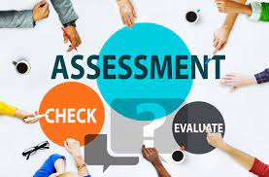
What do you do with the results of your assessment?
Learn more about careers suggested by your assessment.
Explore career options in a peer group.
Your self-assessment is also the basis for how you will determine whether jobs might be a good fit for you or not. Things that come up in your self-assessment as important are things you can ask people in informational interviews about specifically to get an idea for whether their field/position would be a good fit for you.
Each time you have a work experience that you particularly enjoyed or didn't enjoy, take a few minutes to reflect on what you liked or didn't like about that experience. You can keep a journal or document where you keep your reflections for reference later.

Slide 10
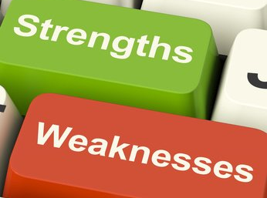
How to identify your strengths and weaknesses?
Assessing your strengths and weaknesses as an early career researcher could be key to your longer-term development.

Slide 11
How to identify your strengths and weaknesses?
Ask yourself questions like: Which of these areas are you most inspired by or interested in? Which of these themes scare you? And finally, on both counts ask yourself why and look at possible ways of changing your perceptions of a competency. You may hold a lot of negativity about something, that if you could remove, you might enjoy and be good at!

Slide 12
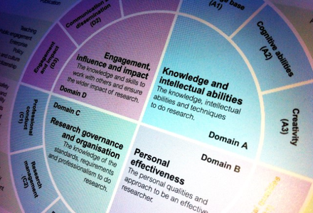
How to identify your strengths and weaknesses?
The RDF is a professional development framework for planning, promoting and supporting the personal, professional and career development of researchers in higher education. It articulates the knowledge, behaviours and attributes of successful researchers and encourages them to realise their potential.
..
Vitae is the EURAXESS Career Development Centre for the UK.
https://www.vitae.ac.uk/vitae-publications/rdf-related/researcher-development-framework-rdf-vitae.pdf/view

Slide 13
Researcher Development Framework
The Framework is designed for:
researchers to evaluate and plan their professional development,
managers and supervisors of researchers in their role supporting the development of researchers,
trainers, developers, human resources specialists and careers advisors in the planning and provision of support for researchers’ development.
It will also be of interest to employers to understand the portfolio of skills unique to researchers and their potential as highly-valued employees

Slide 14
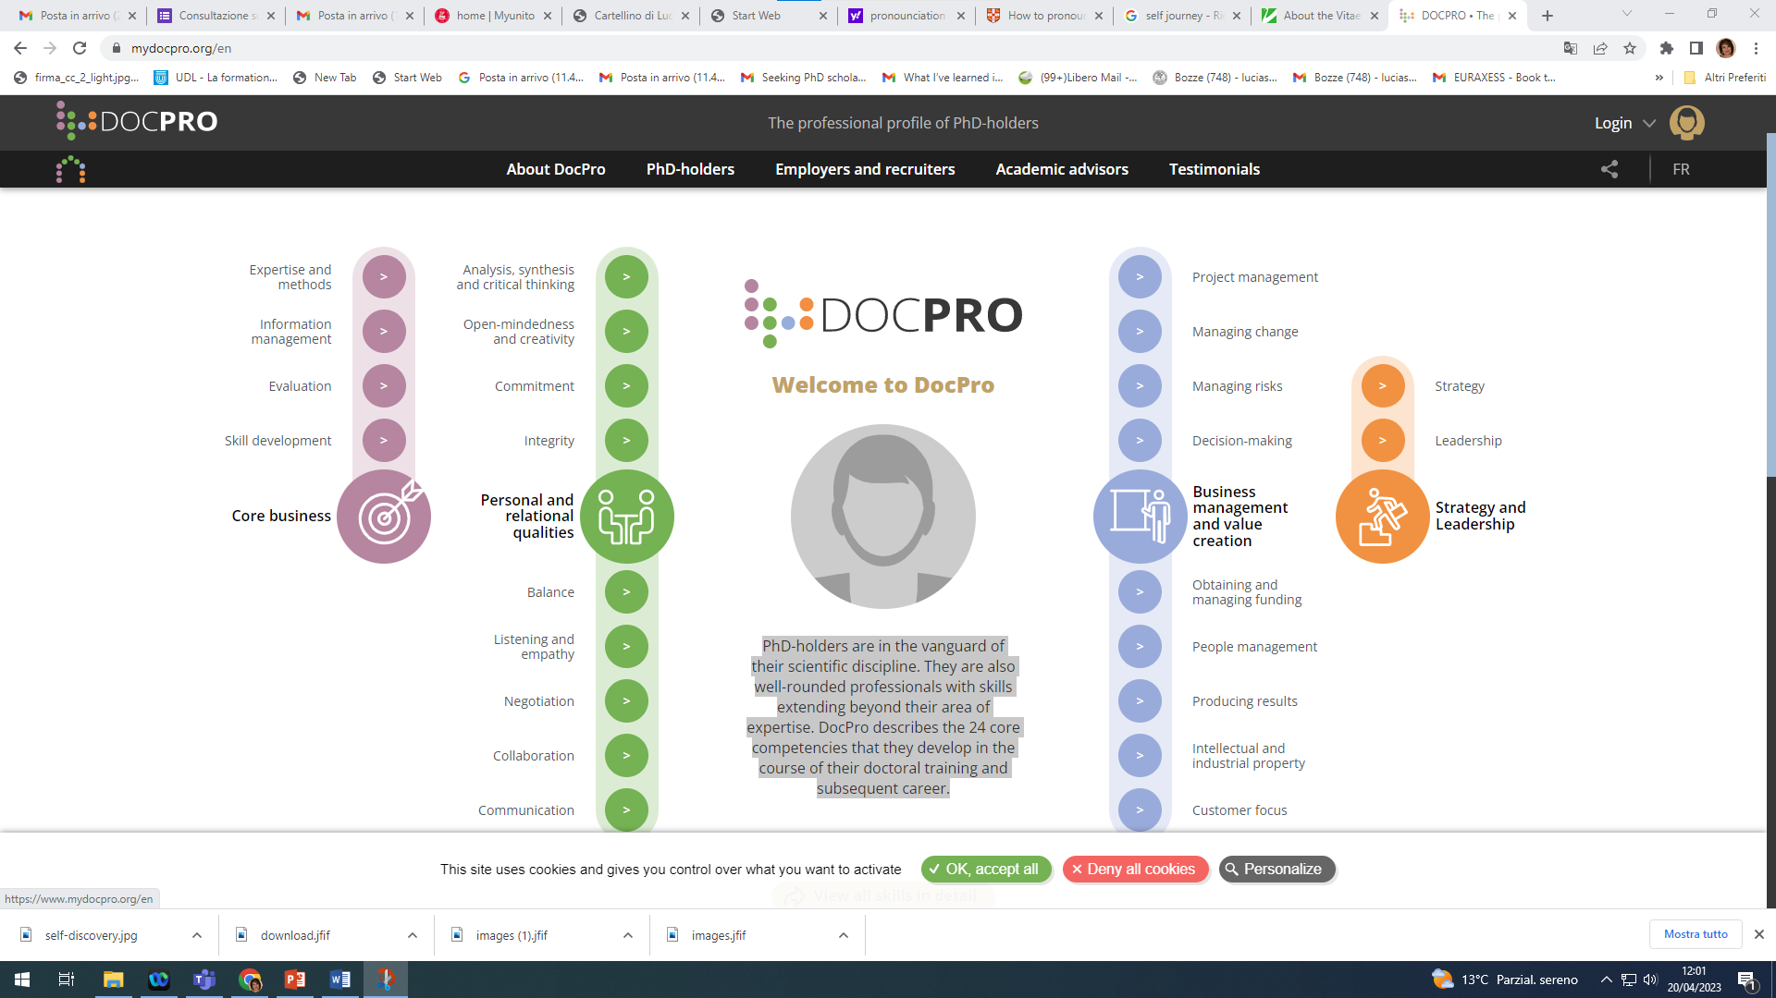
How to identify your strengths and weaknesses?
DOCPRO by ABG, Paris
https://www.mydocpro.org/en
PhD-holders are in the vanguard of their scientific discipline. They are also well-rounded professionals with skills extending beyond their area of expertise. DocPro describes the 24 core competencies that they develop in the course of their doctoral training and subsequent career.

Slide 15
DOCPRO by ABG, Paris
DOCPRO describes the 24 core competencies that PhDs develop in the course of their doctoral training and subsequent career.
DocPro provides an overview of the competencies of PhD-holders to address three key needs:
promoting the idea that a PhD-holder, backed by training in scientific research, is a professional who has acquired all the competencies and people skills needed to meet the needs of the corporate world,
building a bridge between the research and corporate worlds through the development of a common language,
facilitating communication between PhD-holders seeking new career opportunities, and recruitment officers.
https://www.mydocpro.org/en/about-docpro

Slide 16
Find Your Doctor is the sole agency in Italy devoted to specifically favor the employability of PhD holders on the job market outside Academia. Alongside several Italian Universities, the agency empowers PhD students and post docs with respect to their skills and potential as future innovators in a knowledge economy. Thanks to its database, including more than 7000 (and counting) registered reserachers, It also provides companies and non-academic organizations in general with an easy access to the expertise of PhD students and holders all around the country and abroad, selecting specialists for R&D temporary projects, high-profile training courses, staff positions, social innovation initiatives and any project where a PhD-level view can be an asset.

Slide 17
Find Your Doctor is also involved in a constant pro-bono activity aiming to help researchers self-assess, orient on the job market, learn their own value, how to communicate it and the tools that can help figure their future career.
The agency share contents for its community on the social networks (several thousands researchers) and organizes or participate live and on-line events, often in collaboration with PhD organizations such as ADI (Italian Doctorate holders association), Eurodoc and the Marie Curie Alumni Association MCAA.

Slide 18
Career Services
Career Counselling
Career Coaching
Career Consulting

Slide 19
What is a careers consultant?
A careers consultant is an experienced professional who helps an individual overcome specific challenges in their career. What does a careers consultant do?
A careers consultant is responsible for the following tasks:
help people figure out how to make a career change,
offer career insights to entrepreneurs and business leaders,
work with people who have recently become unemployed find a new job,
assist individuals in understanding the qualifications needed for their careers,
administer tests and assessments to understand their clients' skills, personality and working style,
provide career-related guidance to experienced professionals.

Slide 20
What does a Career Coach do?
The concept of career coaching is still relatively new. In a fickle economic climate, both companies and employees are searching for ways to hit that sweet spot.
A career coach works to help their client reach their full potential. He/she helps you reach your long-term goals, while a careers consultant is more focused on helping you find the solution to a specific problem. For instance, a careers consultant may help you improve your interview skills or rewrite your resume.

Slide 21
What does a Career Coach do?
Here are some things a career coach does.
Navigate career transitions.
Provide career advice.
Help job seekers with job interview skills (including practicing mock interviews).
Examine career assessment results and provide guidance.
Assist with career planning.
Help to set career goals and long-term professional goals.
Explore new career options and opportunities .
Advise on how to build your personal brand.
Find work-life balance by setting boundaries and examining priorities.
Assist in the job search process.
Find footing in a new role or new job.
Explore ways to upskill or reskill in a current job.
Identify new strategies to enhance career development .

Slide 22
What is a Career Counselor ?
The primary goal of a career counselor is to assist individuals in identifying their strengths, interests, and skills and match them with career opportunities that align with their values and goals. They provide guidance and support throughout the career exploration process, which includes identifying career goals, researching job prospects, and developing a plan for achieving those goals. Career counselors also assist with job search strategies, resume and cover letter writing, and interview preparation.

Slide 23
Career coaching is similar in nature to career counseling. A career counselor provides you with industry information and advice to help you find a job. A career coach does the same, but also takes a deeper look at your life as a whole, paying attention to your values, strengths and interests.
A career advisor helps you with your job search.

Slide 24
Why do PhDs need career counseling?
The goal of Career Counseling is to not only help you make the decisions you need to make now, but to give you the knowledge and skills you need to make future career and life decisions.
Career counselling is a process that helps individuals identify and explore career options, make informed decisions about their future, and develop strategies to achieve their goals. It can be helpful at any stage of life, but it is especially beneficial for young people who are just starting out in their careers.

Slide 25
Why do PhDs they need a career counseling?
Explore their interests, values, and skills: A career coach can help an individual in exploring their interests, values, and skills. This can be done through a variety of assessments and exercises that help the individual to identify these areas. Once these areas are identified, the career coach can help the individual to develop a plan to pursue their goals. This may include setting up informational interviews, researching different careers, and exploring job opportunities.

Slide 26
Why do PhDs they need a career counseling?
Understand the relationship between their education and career goals.
Career counselling helps individuals understand the relationship between their education and career goals. It can assist individuals in making informed decisions about their future by exploring different career options and the educational requirements needed to pursue those options. Career counselling can also help individuals identify their strengths and weaknesses, and understand how these factors can impact their career choices.

Slide 27
Why do PhDs they need a career counseling?
Make informed decisions about their future: Career coaching helps individuals in making informed decisions about their future by providing them with information about various career options, the pros and cons of each option, and the steps required to pursue each option. Develop strategies for achieving their goals: An experienced coach can help individuals in a number of ways. It can assist with identifying and exploring career options, developing job search strategies, writing resumes and cover letters, preparing for interviews, and understanding and managing job stress. They can also provide resources and advice on networking, interviewing, and job search strategies. It can also help individuals assess their strengths and weaknesses, set realistic career goals, and createaction plans for achieving those goals.
action plans for achieving those goals.

Slide 28
Why do PhDs they need a career counseling?
Navigate the job market: a career guidance counsellor can help an individual learn about different job options that are available, and help them understand the job market. Manage career transitions: a career guidance counsellor can help an individual manage their career transitions by providing support and guidance throughout the process. They can help with exploring new career options, identifying transferable skills, and creating a plan to make the transition.

Slide 29
What usually do What does a Caree Consultant usually do?

Slide 30
Career Consultant/Career Coach
The consultant can assess the background, skills, and experience of the client and identify other career options that may or may not have occurred to the displaced employee. This process is important, since it can lead to discovering a whole new way to make use of the abilities of the employee in a new setting, or at least identify what type of training would be needed to make the employee attractive to prospective employers. Since the object is to capitalize on the skills of the client while also taking into consideration the short term and long term goals related to the workplace, the career consultant can help the client establish a plan for meeting the needs of today, while building a foundation for career advancement in the future.

Slide 31
Asking for a pay rise
If you're not comfortable asking for a raise or you don't know how to ask, career coaches can guide you on how to proceed. They usually know about salary structures and pay grades, and they can help you ask for a fair sum. They may advise you on the best language to use when writing a letter requesting a pay rise or how you could approach your manager with this topic.

Slide 32
Asking for something you require
If you're finding it challenging to ask for additional things that you require at work, career coaches can help. They can provide you with tips and guide you toward the best solution. This may involve asking for management assistance, necessary equipment or training for your projects.

Slide 33
Managing workplace interactions
A career coach can advise you on how to manage awkward work relationships. They can also help you improve your communication and problem-solving skills, which can allow you to build and maintain positive relationships at work.
Promoting yourself
Professional career coaches typically follow the latest trends in hiring and recruiting. They're qualified to offer guidance on creating cover letters, updating resumes, organising portfolios of work samples and utilising applicant tracking tools. With this information, you can promote yourself in the best way possible.

Slide 34
Preparing for an interview
A job coach can provide you with advice and assist you in exercising your interview skills so that you're prepared and confident for your next interview. They may prepare questions for you to practise or host a mock interview to give you experience. A successful interview can help you advance in your career.

Slide 35
Handling a position termination
Career coaches can assist you in finding new jobs in your current field or in a completely different one.
Creating a bold plan
For example, they may help you brainstorm your long-term goals and establish smaller short-term objectives that can help you reach your career aspirations.

Slide 36
Enhancing your leadership skills
Career counsellors can help you grow in your current position. For example, if you're a leader in an organisation, they can help you enhance your leadership abilities. A career coach can help you identify your skills and key strengths, plus areas that you can improve further, by paying attention to the areas where you're most productive and giving honest feedback in areas where you may improve.

Slide 37
Trying to find a cultural match
It's possible that you're not compatible with your workplace's culture. A career counsellor can objectively assess your personality, which can assist you in determining whether your current workplace culture is the best environment for you.
Evaluating a conflict at work
A career coach can serve as a valuable aid in helping you evaluate workplace conflicts. Your coach can be an impartial party who helps you determine the best course of action to resolve work-related tension. For example, your career coach could work one-on-one with you to help you decide the best strategy to manage conflict.

Slide 38
Seeking career growth
A career coach can help you find opportunities to advance in your current workplace by identifying potential employers. This is beneficial if there's a chance that you're overlooking possible job prospects.

Slide 39
What their expectation of career counseling should be?
Defining goals.
Creating room for self-exploration.
Understanding the job market.
Helping turn life themes into career goals.

Slide 40
CAREER DEVELOPMENT ACTIVITIES FOR OUR DOCTORAL STUDENTS (University of Torino)
Organization of different activities and implementation of different projects in order to:
help our PhDs prepare their postdoctoral career path with a particular focus on careers beyond Academia,
strenghten their soft skills,
become aware of their full potential in terms of transferable skills,
valorize skills acquired during doctoral training,
explore and understand the job market,
understand the recruitment process,
overcome a job interview,
build and expand their professional network etc.,

Slide 41
Types of activities and projects offered to our PhDs
Soft skills training workshops and webinars run by experienced trainers (elevator pitch, scientific writing, fundraising, intellectual property, project managment, career coaching, social media strategy and personal branding).
Round tables and panel discussions with HR professionals, head hunters, European recruiters, Alumni PhD with original and interesting jobs
Business dinner with recruiters from different companies and start-up
Mock interviews with real HR professionals
Doc Talk with our Alumni
Participation to Career Fairs only for PhDs
Career Tracking Project funded by Fondazione CRT
Employability of our PhD Graduates
Our Alumni Community
CAREER DEVELOPMENT ACTIVITIES FOR OUR DOCTORAL STUDENT

Slide 42
Lucia Salto
Career Development Facilitator for PhDs Research Dep. University of Turin lucia.salto@unito.it dottori.phd@unito.it

